Slide 1
ALZ-NET (4709) eCRF Training
Migration #6 - Updates
Kathleen Donahue – Senior Clinical Data Manager
June 2024

Slide 2
Form Roll-out in Follow-Up Folders
After Migration 5, it was discovered that the following forms were not rolling out as expected within the Follow-Up folders –
Follow-up Concurrent Study Enrollment
Additional Measures

Slide 3
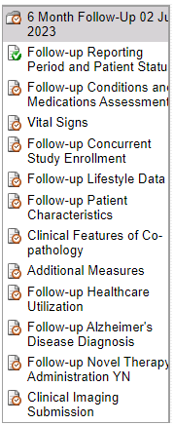
Form Roll-out in Follow-Up Folders
These forms should now be appearing in the Follow-up for those patients whose reporting periods came due between 01FEB2024 and 21MAY2024.
Please review those cases and complete the two forms as necessary.

Slide 4
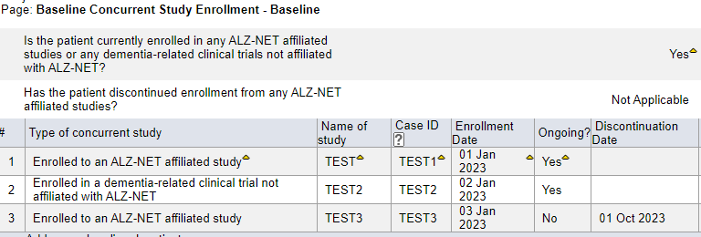
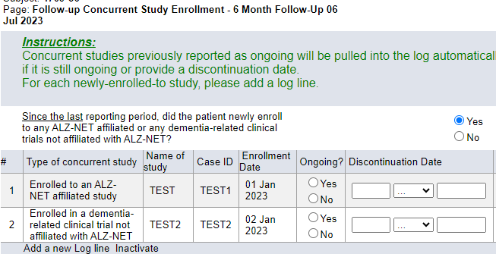
Follow-up Concurrent Study Enrollment
The Follow-up Concurrent Study Enrollment form ‘pulls forward’, to the current data collection timepoint, any concurrent studies which were reported as “Ongoing” during the previous (most recent) data collection timepoint.
If previously reported “Ongoing” studies are not being ‘pulled forward’, please do the following:

Slide 5
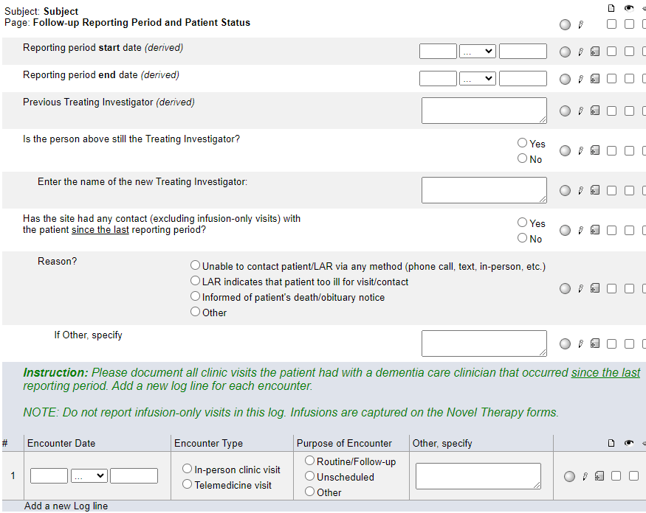
Follow-up Concurrent Study Enrollment
On the Follow-up Reporting Period and Patient Status form, ‘toggle’ the answer to this question.
That is, if you originally entered No, change the answer to Yes and hit Save. Then, change the answer back to No and hit Save.
This should ‘trigger’ the programming and the Ongoing studies will be ‘pulled forward’ into the current Follow-up Concurrent Study Enrollment form.

Slide 6
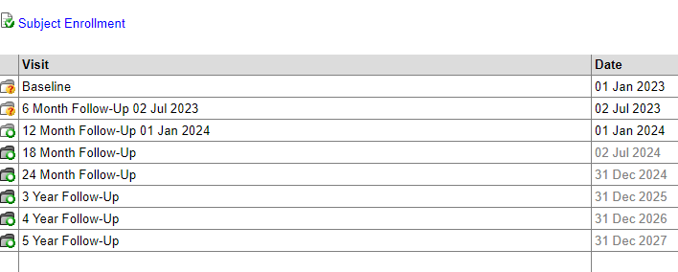
Date Appended to Follow-up Folders
After Migration 5, it was discovered that the reporting period end dates were no longer being appended to the Follow-Up folders.
This should now be working for those patients whose reporting periods came due between 01FEB2024 and 21MAY2024.

Slide 7
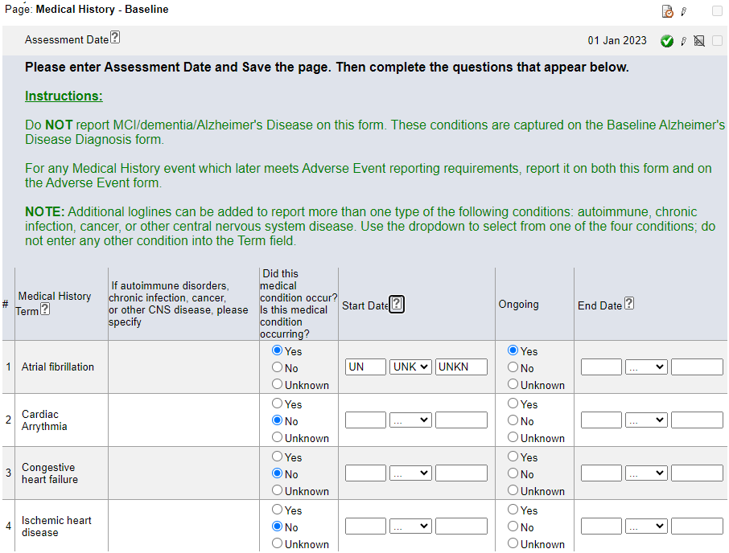
Medical History
Two updates have been made to this form:
The Instructions have been updated to clarify how to report MCI/dementia/Alzheimer’s Disease.
Fully unknown Start Dates can now be reported. Click on the ? icon for HelpText.

Slide 8
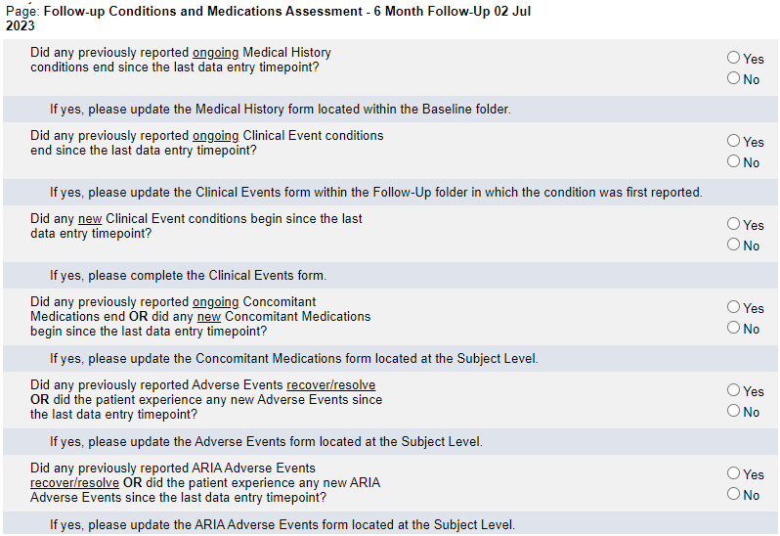
Follow-up Conditions and Medications Assessment
*** NEW FORM ***
This form has taken the place of the Follow-up Adverse Events Assessment form in each Follow-Up folder.
Complete in its entirety and for each Yes response, follow the instructions indicated under the question.

Slide 9
Follow-up Conditions and Medications Assessment
Going forward, the Clinical Events form will no longer appear in every Follow-Up folder.
It will only roll-out when “Did any new Clinical Event conditions begin since the last data entry timepoint?” is answered Yes.
NOTE: If the Clinical Events form was previously completed, it will still be present and available to update.

Slide 10
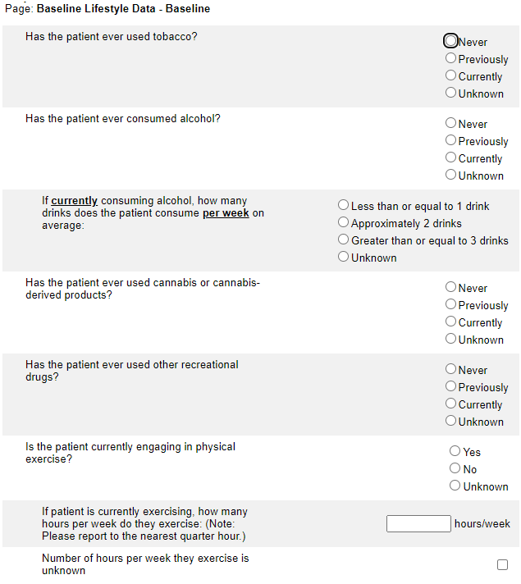
Baseline Lifestyle Data
If “Is the patient currently engaging in physical exercise?” is answered as Yes, indicate either the number of hours/week or use the checkbox to indicate that the number of hours per week is unknown.

Slide 11
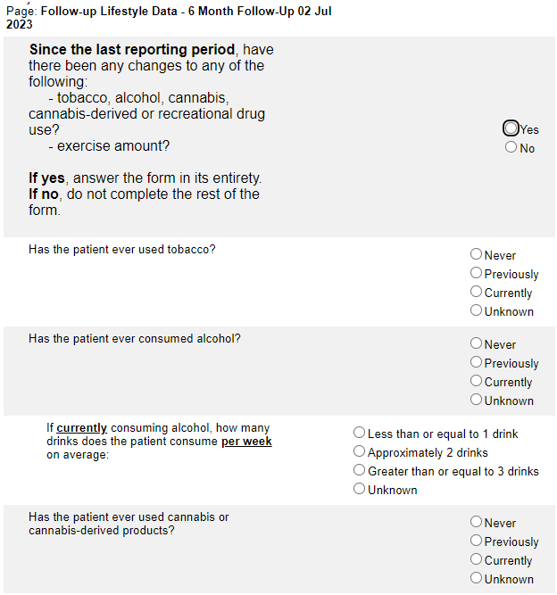
Follow-up Lifestyle Data
If “Is the patient currently engaging in physical exercise?” is answered as Yes, indicate either the number of hours/week or use the checkbox to indicate that the number of hours per week is unknown.

Slide 12
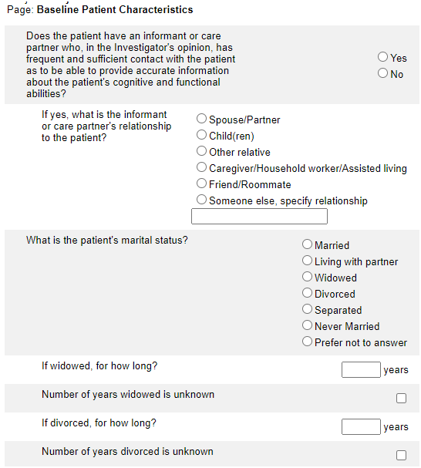
Baseline Patient Characteristics
If the patient is Widowed or Divorced, but the number of years is not known, there is now a checkbox for “Number of years widowed/divorced is unknown”.
Indicate either the number of years widowed/divorced or use the checkbox to indicate that the number of years is unknown.

Slide 13
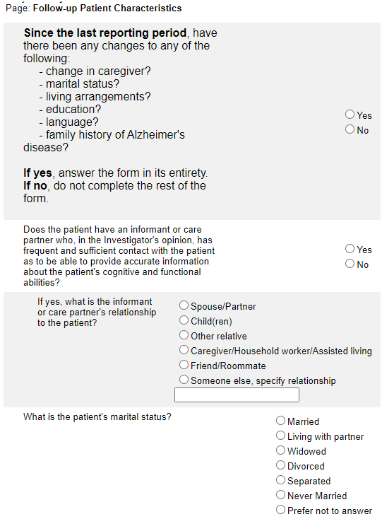
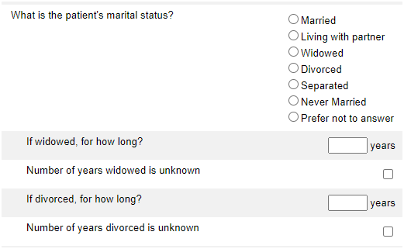
Follow-up Patient Characteristics
If the patient is Widowed or Divorced, but the number of years is not known, there is now a checkbox for “Number of years widowed/divorced is unknown”.
Indicate either the number of years widowed/divorced or use the checkbox to indicate that the number of years is unknown.

Slide 14
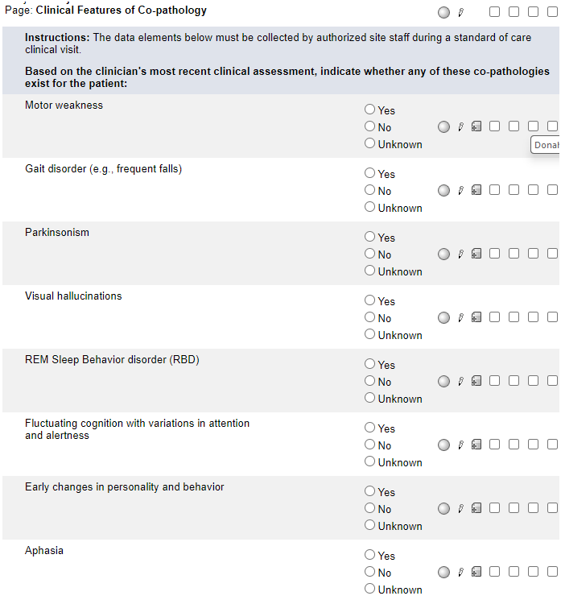
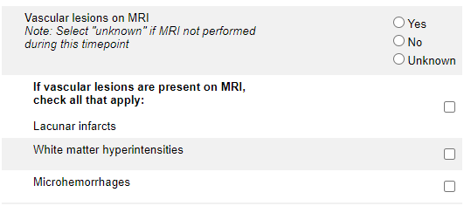
Clinical Features of Co-Pathology
A note has been added to help clarify how to answer the “Vascular lesions on MRI” question.
Answer Yes if an MRI was performed within the timepoint and vascular lesions were present.
Answer No if an MRI was performed within the timepoint and vascular lesions were NOT present.
Answer Unknown if an MRI was NOT performed within the timepoint.

Slide 15
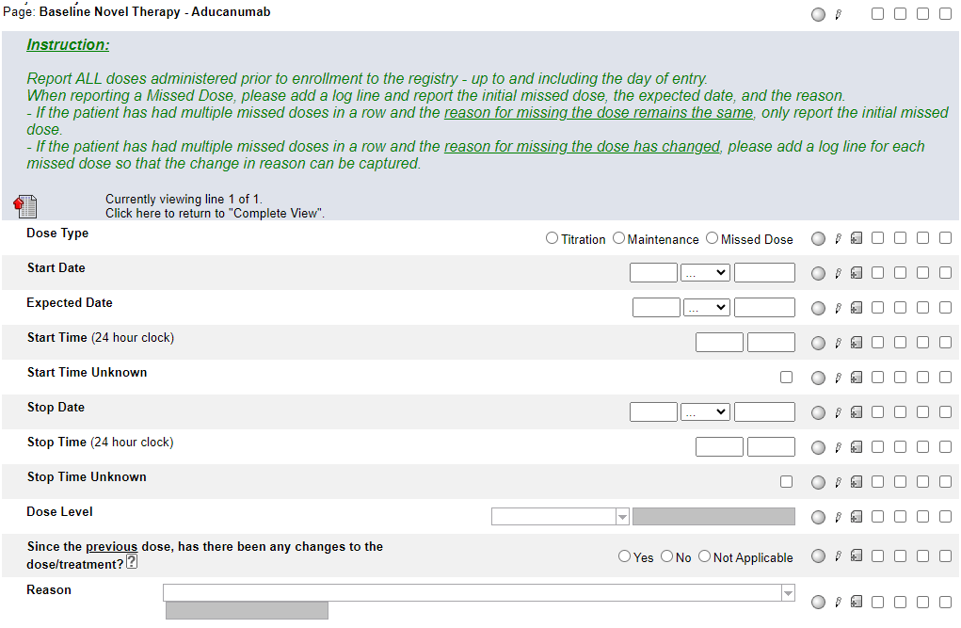
Baseline Novel Therapy - Aducanumab
The two lead questions have been removed.
The instructions have been updated to clarify what doses are required to be reported.

Slide 16
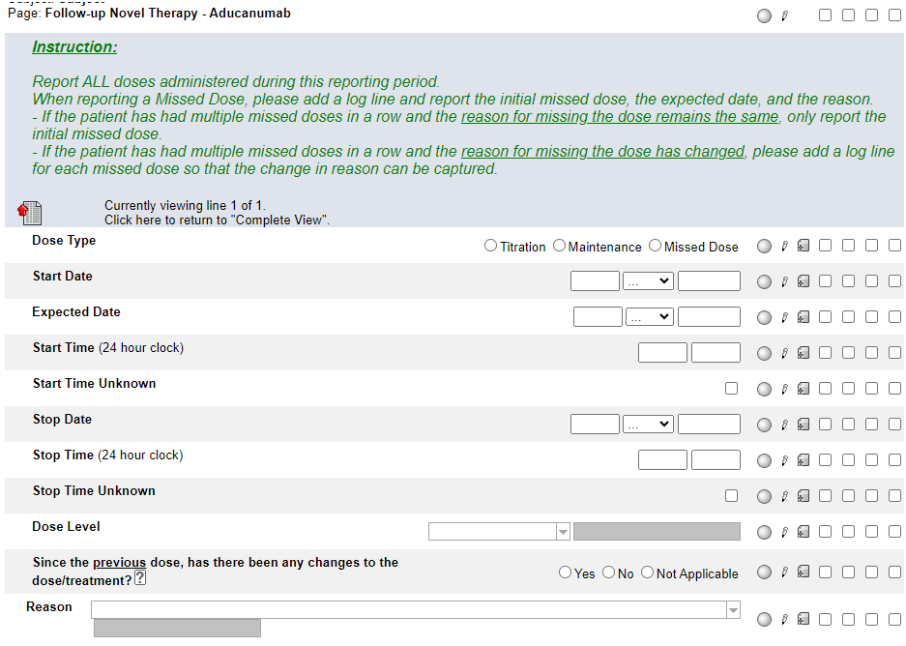
Follow-up Novel Therapy - Aducanumab
The instructions have been updated to clarify what doses are required to be reported.

Slide 17
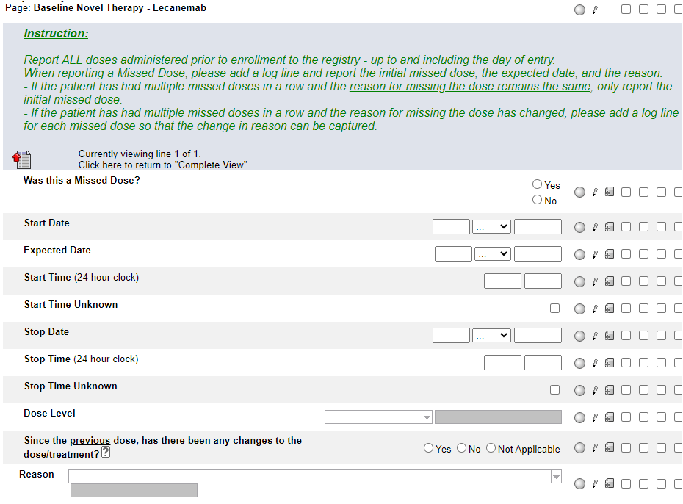
Baseline Novel Therapy - Lecanemab
The two lead questions have been removed.
The instructions have been updated to clarify what doses are required to be reported.

Slide 18
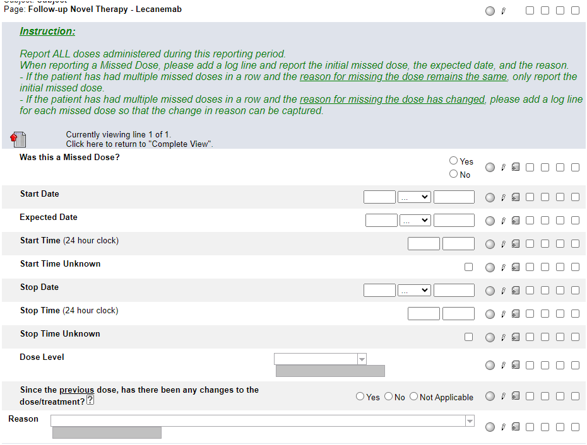
Follow-up Novel Therapy - Lecanemab
The instructions have been updated to clarify what doses are required to be reported.

Slide 19
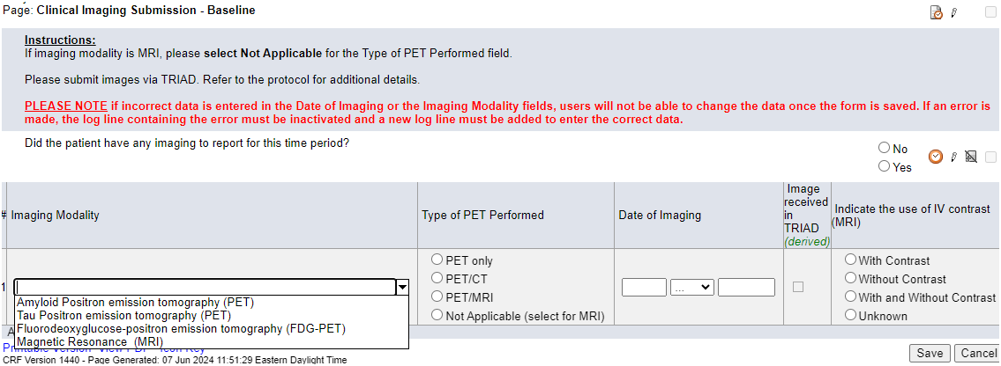
Clinical Imaging Submission
The “Imaging Modality” dropdown menu has been updated to include FDG-PET.
When reporting FDG-PET, complete the log line in its entirety but do NOT complete “Indicate the use of IV contrast (MRI)”

Slide 20
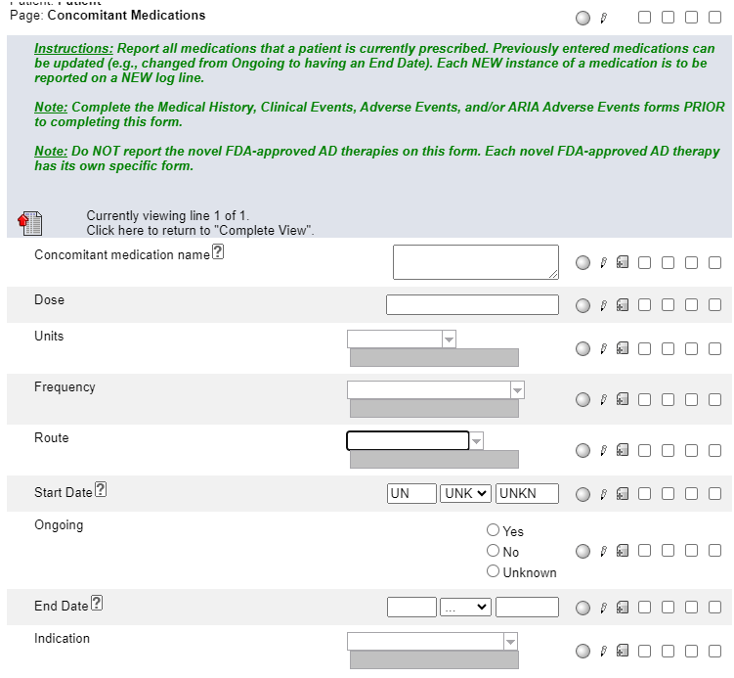
Concomitant Medications
Fully unknown Start Dates can now be reported. Click on the ? icon for HelpText.

Slide 21
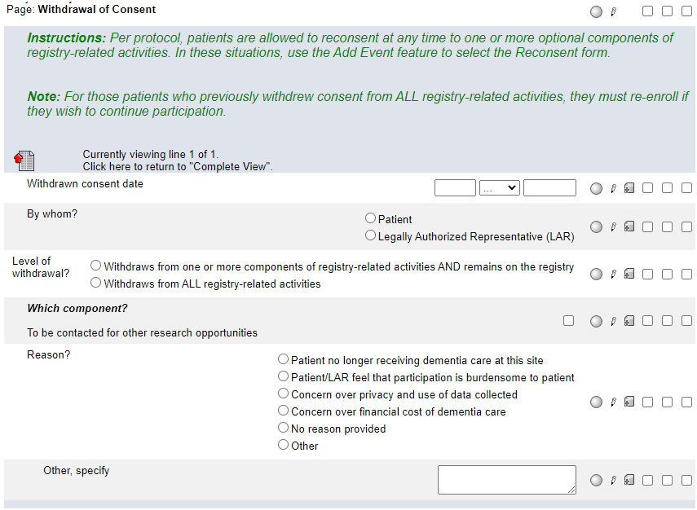
Withdrawal of Consent
The instructions have been updated to remove reference to the previous enrollment system.

Slide 22
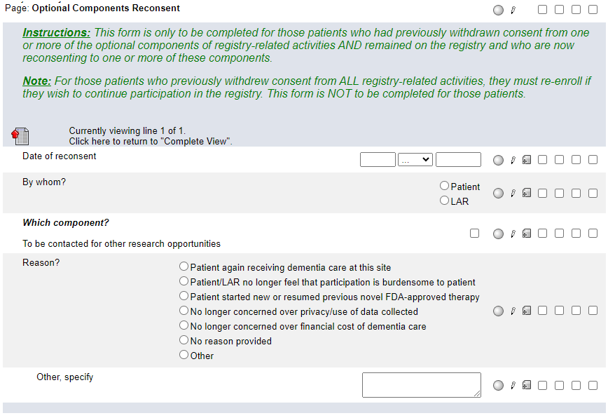
Optional Components Reconsent
The instructions have been updated to remove reference to the previous enrollment system.

Slide 23
Please send any data related questions to:
alznet-data@acr.org

Slide 24
Thank You!

