Slide 1
ALZ-NET (4709) eCRF Training
Migration #7 - Updates
Kathleen Donahue – Senior Clinical Data Manager
August 2024

Slide 2
Form Roll-out in Follow-Up Folders
After Migration 6, it was discovered that the following forms were not rolling out as expected within the Follow-Up folders –
Follow-up Concurrent Study Enrollment
Additional Measures

Slide 3
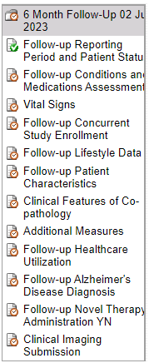
Form Roll-out in Follow-Up Folders
These forms should now be appearing in the Follow-up for those patients whose reporting periods came due between 21MAY2024 and 13AUG2024.
Please review those cases and complete these two forms as necessary.

Slide 4
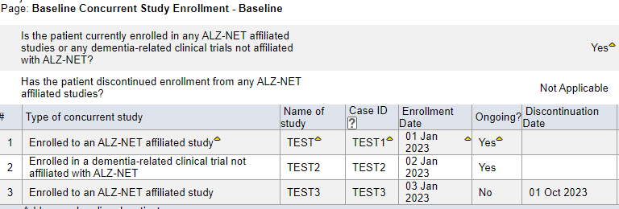
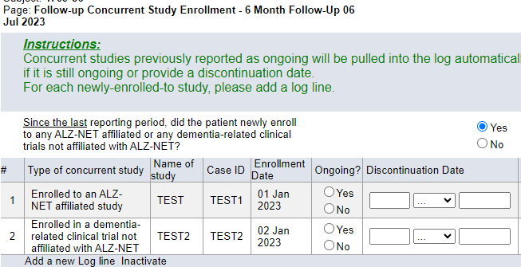
Follow-up Concurrent Study Enrollment
The Follow-up Concurrent Study Enrollment form ‘pulls forward’, to the current data collection timepoint, any concurrent studies which were reported as “Ongoing” during the previous (most recent) data collection timepoint.
If previously reported “Ongoing” studies are not being ‘pulled forward’, please do the following:

Slide 5
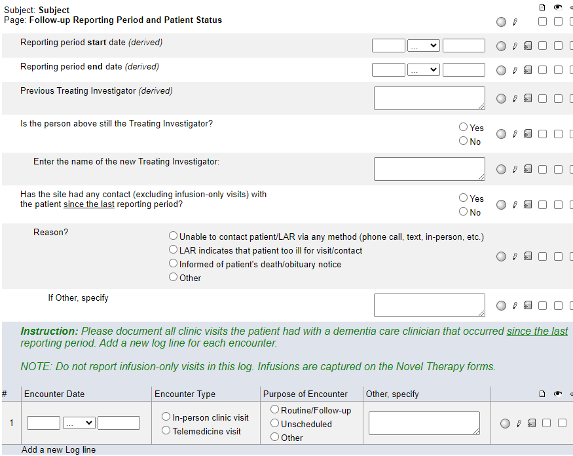
Follow-up Concurrent Study Enrollment
On the corresponding Follow-up Reporting Period and Patient Status form, ‘toggle’ the answer to this question.
That is, if you originally entered No, change the answer to Yes and hit Save. Then, change the answer back to No and hit Save.
This should ‘trigger’ the programming and the Ongoing studies will be ‘pulled forward’ into the current Follow-up Concurrent Study Enrollment form.

Slide 6
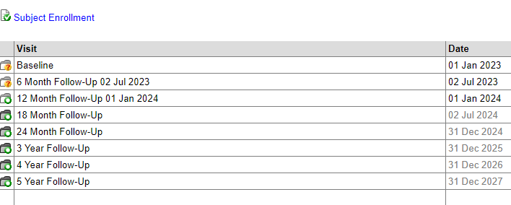
Date Appended to Follow-up Folders
After Migration 6, it was discovered that the reporting period end dates were no longer being appended to the Follow-Up folders.
This should now be working for those patients whose reporting periods came due between 21MAY2024 and 13AUG2024.

Slide 7
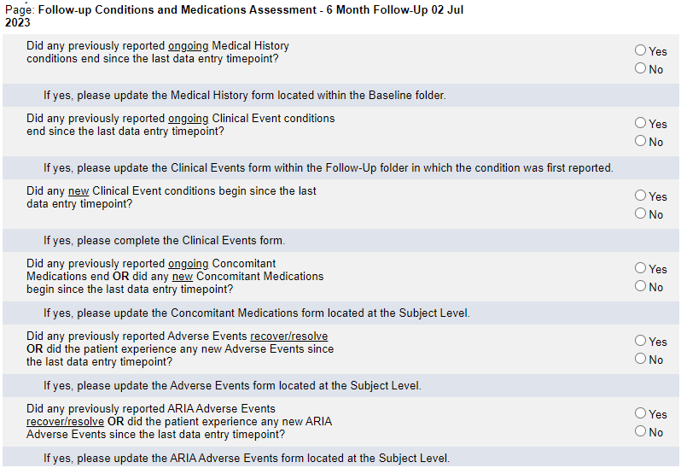
Follow-up Conditions and Medications Assessment
After Migration 6, it was discovered that Clinical Events form was not rolling out for some patients when “Did any new Clinical Event conditions begin since the last data entry timepoint?” was answered Yes.

Slide 8
Follow-up Conditions and Medications Assessment
If the Clinical Events form does not roll-out, please do the following:
‘Toggle’ the answer to this question.
That is, change the answer to No and hit Save. Then, change the answer back to Yes and hit Save.
This should ‘trigger’ the programming and the Clinical Events form will roll-out.

Slide 9
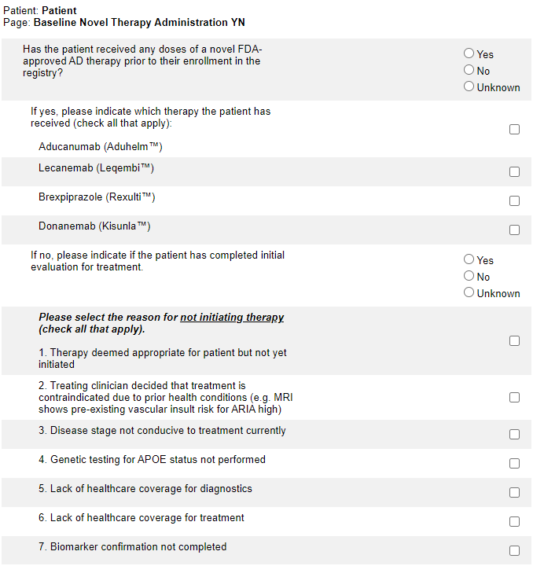
Baseline Novel Therapy Administration YN
Donanemab (KisunlaTM) has been added to the list of novel FDA-approved AD therapies.
NOTE: Because a new field has been added to this form, it will appear on the monthly Overdue Forms report unless you RE-SAVE the form.

Slide 10
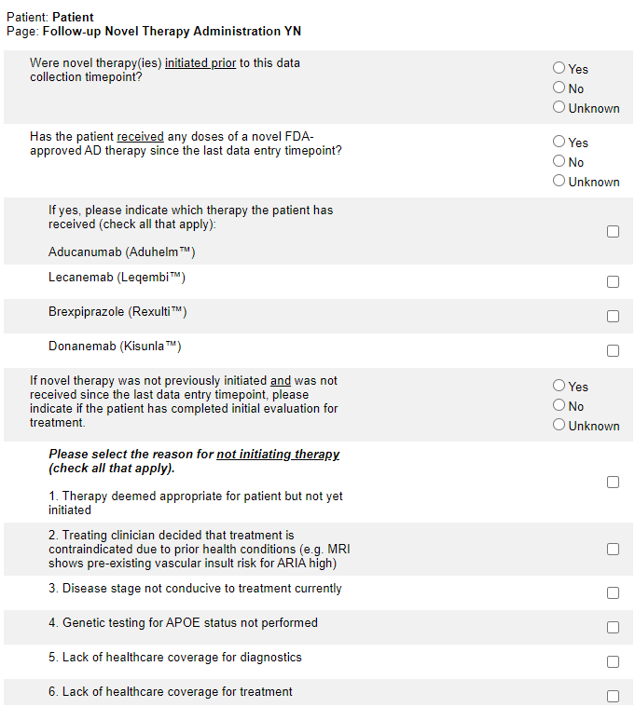
Follow-up Novel Therapy Administration YN
Donanemab (KisunlaTM) has been added to the list of novel FDA-approved AD therapies.
NOTE: Because a new field has been added to this form, it will appear on the monthly Overdue Forms report unless you RE-SAVE the form.

Slide 11
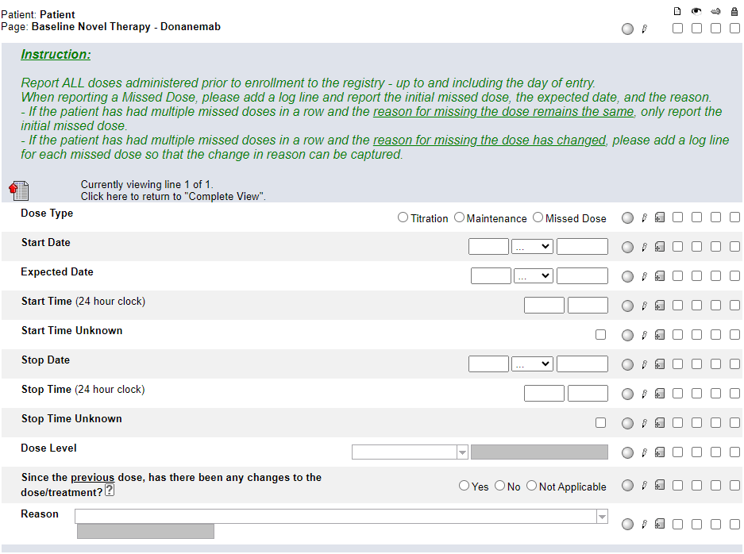
***NEW FORM***
Baseline Novel Therapy – Donanemab
This form only becomes visible and available for data entry when Donanemab is selected on the Baseline Novel Therapy Administration YN form.
Complete a log line for each dose taken prior to enrollment to the registry – up to and including the day of entry.

Slide 12
***NEW FORM***
Baseline Novel Therapy – Donanemab
Pay close attention to the Instructions when reporting a Missed Dose.
When reporting a Missed Dose, enter the Expected Date, answer Yes to “Since the previous dose, has there been any changes to the dose/treatment?” and provide a Reason.

Slide 13
***NEW FORM***
Baseline Novel Therapy – Donanemab
This form is a “portrait log” style. It can be opened by clicking on the header in the log line and closed by clicking on “Complete View”.
See HelpText for clarification on when to use Not Applicable.

Slide 14
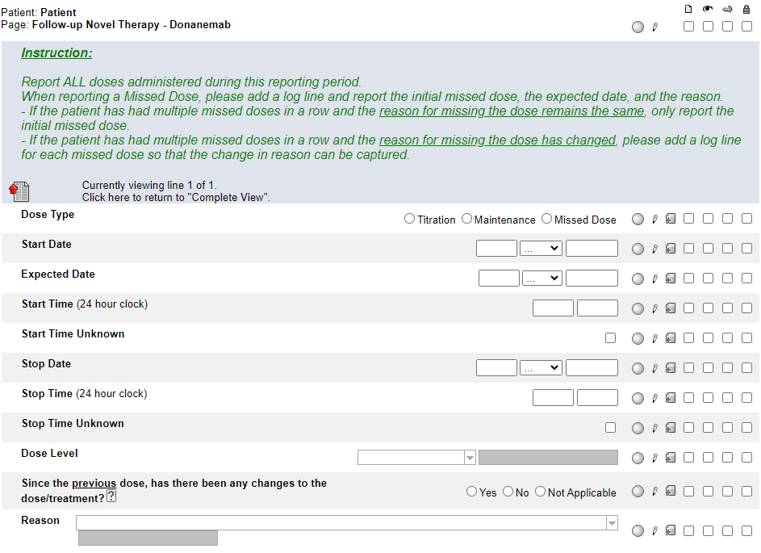
***NEW FORM***
Follow-up Novel Therapy – Donanemab
This form only becomes visible and available for data entry when Donanemab is selected on the Follow-up Novel Therapy Administration YN form.
Complete a log line for each dose taken during the data collection timepoint as indicated on the corresponding Follow-up Reporting Period and Patient Status form.

Slide 15
***NEW FORM***
Follow-up Novel Therapy – Donanemab
Pay close attention to the Instructions when reporting a Missed Dose.
When reporting a Missed Dose, enter the Expected Date, answer Yes to “Since the previous dose, has there been any changes to the dose/treatment?” and provide a Reason.

Slide 16
***NEW FORM***
Follow-up Novel Therapy – Donanemab
This form is a “portrait log” style. It can be opened by clicking on the header in the log line and closed by clicking on “Complete View”.
See HelpText for clarification on when to use Not Applicable.

Slide 17
Please send any data related questions to:
alznet-data@acr.org

Slide 18
Thank You!

